Slide 2
Paula Januszkiewicz
Hackers’ Perspective on Remote Working:
Know the Risks, Fight the Tricks

Slide 3


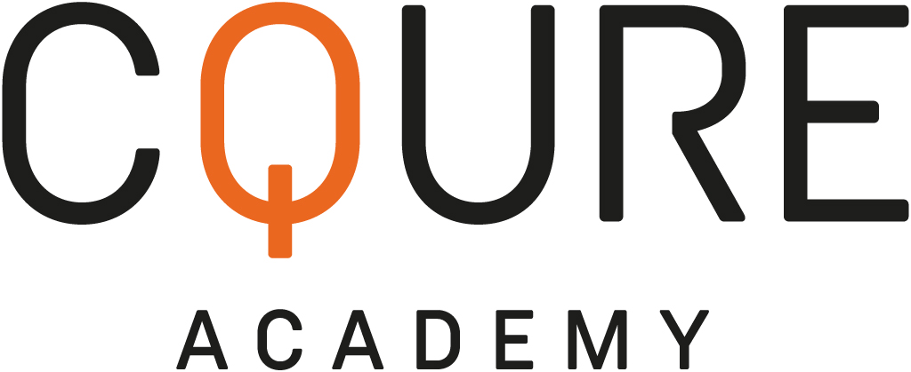
Hackers’ Perspective on Remote Working:
Know the Risks, Fight the Tricks
Paula Januszkiewicz
CQURE: CEO, Cybersecurity Expert
CQURE Academy: Trainer
Microsoft Regional Director
MVP: Cloud and Datacenter Management
www.cqureacademy.com
paula@cqure.us
@paulacqure
@CQUREAcademy

Slide 4

What does CQURE do?
Consulting Services:
Extensive IT Security Audits and Penetration Tests of all kinds,
Configuration Audit and Architecture,
Design Social Engineering Tests,
Advanced Troubleshooting and Debugging,
Emergency Response Services
R&D & CQLabs Tools & Hacks Publications
Trainings & Seminars:
Offline (mainly in New York or via our partners worldwide),
Online

Slide 5




Impactful Hacking Stats – 2021 Summary
316 days to locate and contain the breach, compared to the regular average of 287 days because of the remote work | 30% This is how much businesses could save up if they could contain a breach within 200 days | 20% Share of breaches initially caused by compromised credentials | 85% of breaches involved the human element
Source: Trend Micro, IBM, Verizon (2021)
Notes:
Organizations with more than 50% of their workforce working remotely took nearly 316 days

Slide 6



Remote work by the numbers
PEOPLE WILL USE THEIR PERSONAL MOBILE DEVICES ON THE JOB, REGARDLESS OF WHETHER THEIR ORGANIZATION HAS A FORMAL ‘BYOD’ POLICY
Use a personal electronic device for work-related functions
81%
Connect to a company via a free or public wi-fi connection
31%
Who use a personal electronic device for work-related functions say their company has not implemented a BYOD policy
66%
Who use a personal device for work let someone else use it
46%
SOURCE: ESET, Harris Interactive

Slide 7
Six Techniques to Have Your Infrastructure Prepared for a Battle

Slide 8
#1 Well Configured Firewall

Slide 9
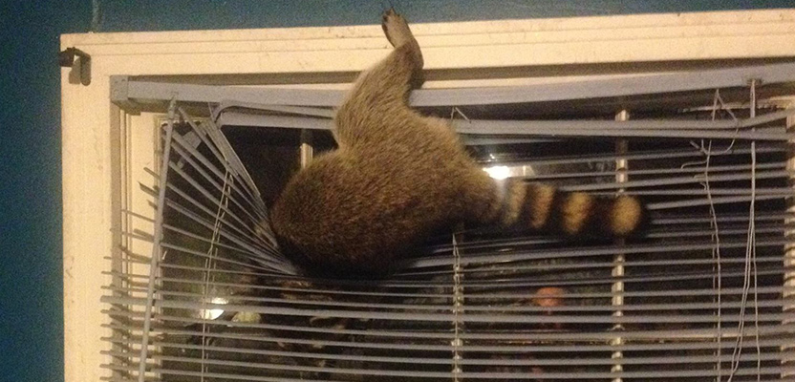

#1 Well Configured Firewall
Key learning points:
Windows Firewall is often misconfigured
Firewall is a great segmentation tool
You can allow only certain processes to communicate with the Internet or locally
No need-to-know processes to block them, you can operate on the services list

Slide 10
Demo: Phishing Little

Slide 11
#2 Usage of MFA and Conditional Access

Slide 12
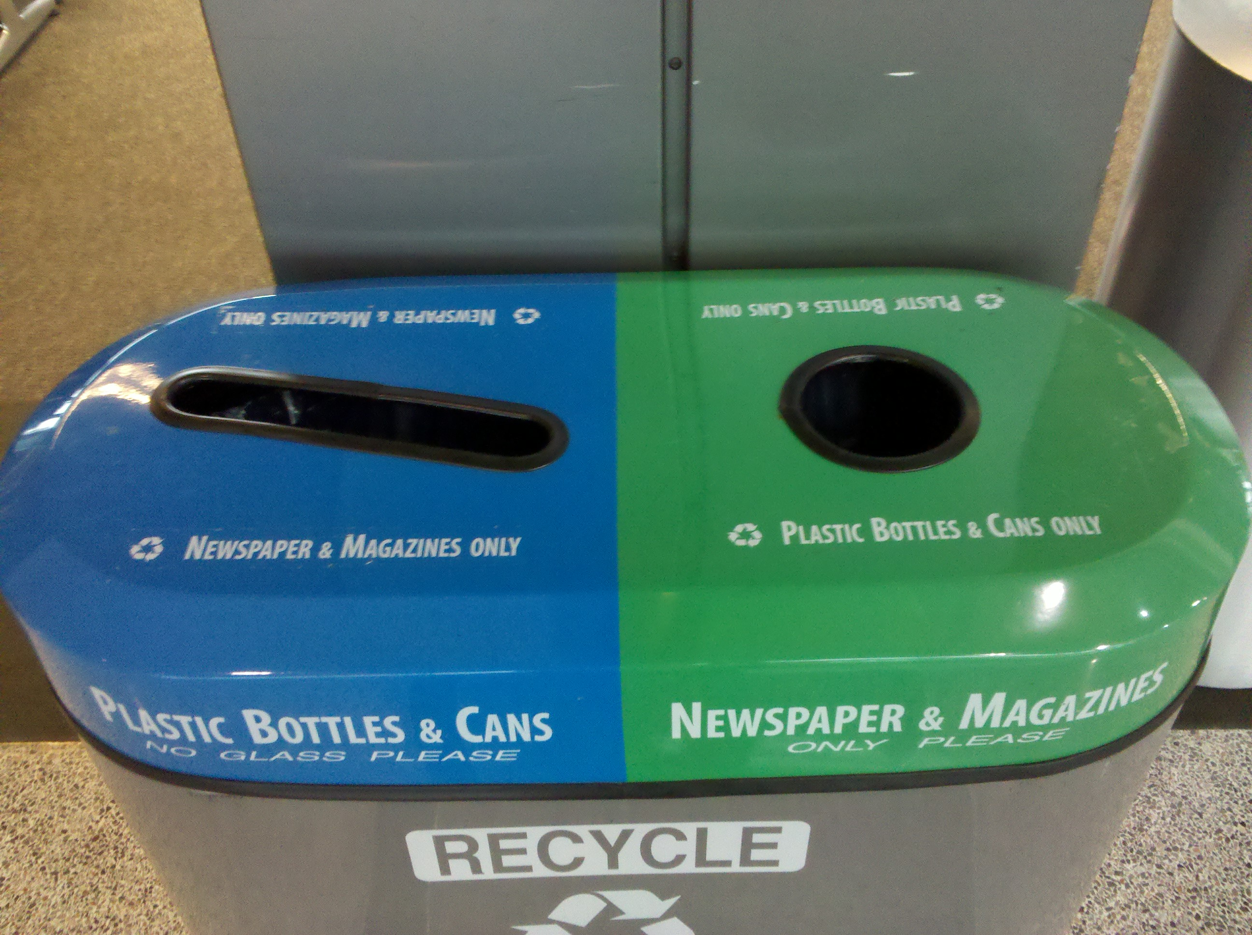
#2 Usage of MFA and Conditional Access
Key learning points:
Passwords are almost always re-used
There is almost always (ekhm… always) some variant of the company name with some number (year, month etc.)
It's highly reasonable to check for obvious passwords and continuously deliver security awareness campaigns

Slide 13
Demo: Bypassing MFA

Slide 14
#3 Network Segmentation and SMB Signing

Slide 15
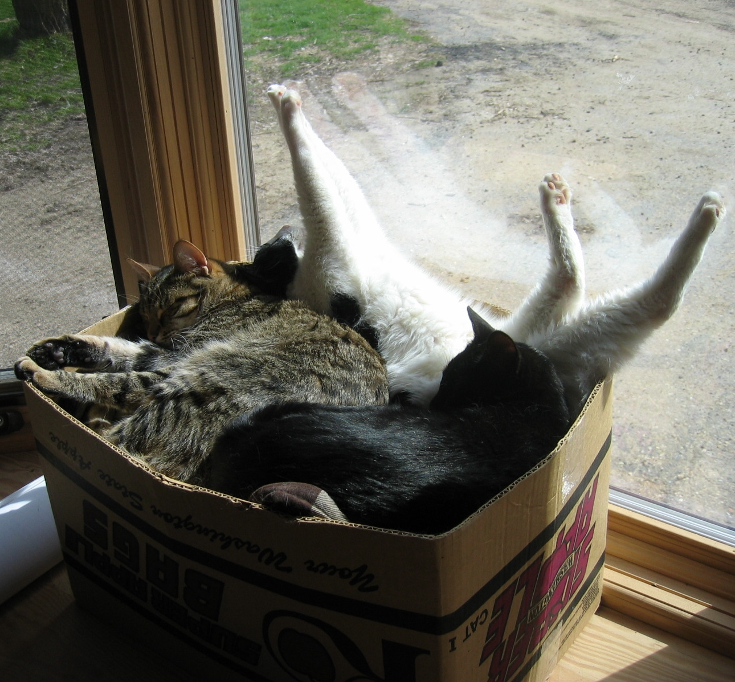
#3A Network segmentation
Key learning points:
Network segmentation can be a blessing or a curse
Greater control over who has access to what
Allows rules to be set to limit traffic
Allows exposure to security incidents to be reduced
Performance: allows Broadcast Domains to be reduced so that broadcasts do not spread on the entire network

Slide 16
Demo: VPN Pivoting

Slide 17

#3B Server Message Block Signing (or alternative)
Key learning points:
Set Service Principal Names (SPN) for services to avoid NT LAN Manager (NTLM):
Reconsider using Kerberos authentication all over
https://technet.microsoft.com/en-us/library/jj865668.aspx
Require SPN target name validation
Microsoft network server: Server SPN target name validation level
Reconsider turning on SMB Signing
Reconsider port filtering
Reconsider code execution prevention but do not forget that this attack leverages administrative accounts

Slide 18
#4 Whitelisting

Slide 19

#4A Disallowing unusual code execution
Key learning points:
Common file formats containing malware are:
.exe (Executables, GUI, CUI, and all variants like SCR, CPL etc.)
.dll (Dynamic Link Libraries)
.vbs (Script files like JS, JSE, VBS, VBE, PS1, PS2, CHM, BAT, COM, CMD etc.)
.docm, .xlsm etc. (Office Macro files)
.other (LNK, PDF, PIF, etc.)

Slide 20

#4B Whitelisting on board
Key learning points:
Code execution prevention implementation is a must
PowerShell is an ultimate hacking tool, possible solutions: block it for users, use Just Enough Administration etc.
Verify where users have write access to: accesschk.exe –w .\users c:\windows
AppLocker can run in the audit mode
AppLocker is great but not with the default configuration

Slide 21
#5 Configuration Audit

Slide 22

#5A Decommission of old protocols or their default settings
Key learning points:
SNMPv3 addresses: user-based system for access control, a means to properly authenticate users, and a method for encrypting SNMP traffic between agent and host
SQL issues – TDS provides by default lack of encryption
ODBC Driver – check if it has a secure networking layer built into it

Slide 23
Demo: Clear Text Queries

Slide 24

#5B Review of the solutions that we trust by default
Key learning points:
The best operators won't use a component until they know how it breaks.
Almost each solution has some ‘backdoor weakness’
Some antivirus solutions can be stopped by SDDL modification for their services
Configuration can be monitored by Desired State Configuration (DSC)
DSC if not configured properly will not be able to spot internal service configuration changes
Example: How do I get to the password management portal?

Slide 25
Demo: Common PKI Pitfalls

Slide 26

#5C Do not fall for hipster tools
Key learning points:
Personal data was involved in 58% of breaches in 2020 (Verizon)
The average time to identify a breach in 2020 was 207 days (IBM)
With increasing budget the risk of possessing hipster tools increases too – do we know where these tools come from and what are their security practices?
Lots of solutions where not created according to the good security practices (backup software running as Domain Admin etc.)
Each app running in the user’s context has access to secrets

Slide 27
#6 Connecting the dots (monitoring identity etc.)

Slide 28

#6 Monitoring privileged accounts and identity misuse
Key learning points:
gMSA can also be used for the attack
Service accounts’ passwords are in the registry, available online and offline
A privileged user is someone who has administrative access to critical systems
Privileged users have sometimes more access than we think (see: SeBackupRead privilege or SeDebugPrivilege)
Privileged users have possibility to read SYSTEM and SECURITY hives from the registry

Slide 29
Demo: Accounts with Issues

Slide 30
Demo: DPAPI Beauty

Slide 31
Why human factor is so important?

Slide 32


Summary
#1
Well Configured Firewall
#4
Whitelisting
#2
Usage of MFA and Conditional Access
#5
Configuration Audit
#3
Network Segmentation and SMB Signing
#6
Connecting the Dots
(monitoring identity etc.)

Slide 33
Summary
Every employee in the organization is the first line of defense when it comes to protecting your organization from cyber threats.
Be cautious of links and attachments in emails – double check with the sender if you feel uneasy.
Remote workers will continue to be a target for cybercriminals. As a side effect of remote workforces, cloud breaches will increase.
Never leave your devices unlocked and unattended.
Prevention is the key to success:
How can we know what to prevent if we do not know what is the threat?
The cybersecurity skills gap will remain an issue. It’s time to act – now!

Slide 34
Best Practices
Continuous vulnerability discovery
Configuration reviews
Context-Aware Analysis
Put on the Hacker’s Shoes
How can we know what to prevent if we do not know what is the threat?
Prevention is the key to success
Remediation and Tracking
Prioritization

Slide 35
Slides and demos from the conference will be available at
https://github.com/nordicinfrastructureconference/2022

Slide 36
THANK YOU!

